Slide 1
Algorithms and Data Structures
Week 1
Semester 1 2025
Dr. Pierpaolo Dondio

Slide 2
Week 1 Outline
About myself
Introduction to the course and logistics
Topics covered
What is an algorithm?
What is a data structure?
A quick refresh of Java programming
Algorithm of the week: The Sieve of Eratosthenes

Slide 3

About Myself
From Lake Garda, Italy
It is my first year at Maynooth University
Research fields
Reasoning systems
Game-based learning
Human Analytics
Office: TBD

Slide 4
Evaluation
90% Written Exam
10% Labs (lab quizzes)
Labs are not graded… except:
2 Lab Quizzes (Week 5 and Week 10) are graded, 5% each

Slide 5
Resources
Introduction to Algorithms (by Thomas H. Cormen, Charles E. Leiserson, Ronald L. Rivest, and Clifford Stein)
Data Structures and Algorithms in Java (by M.T.Goodrich, R.Tamassia, and M.H. Goldwasser
All the material on Moodle (slides, labs, examples..)
Some good material from the web. For instance, here is a short but good course of Algorithms and Data Structure: https://www.youtube.com/watch?v=8hly31xKli0

Slide 6
Lessons plan
Introduction and review of Java
Review of Java, lists (arrays) and binary search
How to measure an algorithm: big O notation and complexity
Sorting Algorithms
Recursive algorithm (+ Quicksort)
Advanced lists and Hash tables
Stacks, queue, priority
Montecarlo simulation: solving problems without an algorithm
Tree structure
Graph-based algorithms
Review week

Slide 7

A little side topic…
A message for all ChatGPT lovers….

Slide 8
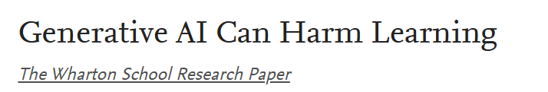

Bastani, Hamsa and Bastani, Osbert and Sungu, Alp and Ge, Haosen and Kabakcı, Özge and Mariman, Rei, Generative AI Can Harm Learning (July 15, 2024). The Wharton School Research Paper
Comparison on a Maths Test with no GPT
No GPT
Baseline
Improvement
1000 High School Students
GPT-4 Base
+48%
-17%
GPT-4 Tutor
+127%
<-1%

Slide 9
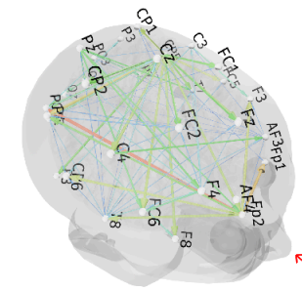
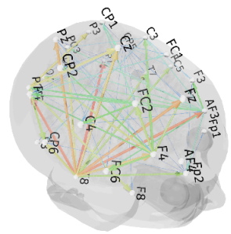
Your Brain on ChatGPT: Accumulation of Cognitive Debt when Using an AI Assistant for Essay Writing
Kosmyna, Nataliya, et al. arXiv preprint arXiv:2506.08872 4 (2025).
ChatGPT
4 months of Essays writing and cognitive tasks
ChatGPT
54 Adults
Google
EEG measuremts
Brain-only
Brain Only
The ChatGPT group showed
lowest neural activation, in memory, attention, and executive control areas.
Harder to recall their own writing.
More formulaic/copy-paste writing style, less ownership of the material.

Slide 10

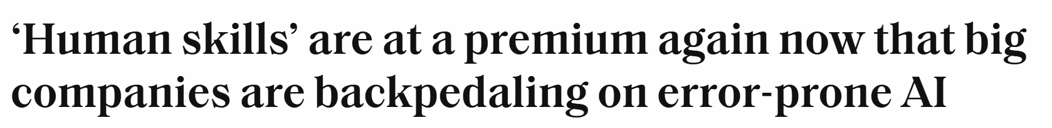
10th September 2025
U.S. Census data: AI adoption declined from 14% to 12%, after rapid growth
Firms are reassessing AI’s limits: problems like hallucinations and quality control.
There is a rising demand for human skills such as judgment, communication, domain expertise, humans able to spot when an AI tool is making a mistake.
Are schools preparing students properly for this moment, when AI is raising the bar on entry-level hiring?
Educators warn students are ill-prepared for a labor market where “human premium skills” are increasingly valued.

Slide 11
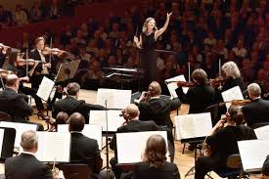
Orchestra Directors
It is not sufficient anymore for students in CS to be good developers: GenAI will likely win a coding competition
It is a hard time for students, you need higher skills
GenAI will amplify your skills, but you need first tohave some skills, and you can build them with hard work!
There are no more players, only orchestra directors: it is important to develop skills as critical thinking, abstract thinking.
This module can help!

Slide 12
What is an algorithm?
Informal Definition: An algorithm is a precise, step-by-step set of instructions for solving a problem or completing a task.
Everyday Examples: Think of a recipe for baking a cake or the directions for assembling a piece of furniture. These are simple algorithms we follow every day.
In computer science: an algorithm is a finite, well-defined sequence of unambiguous instructions that, when executed, produces a result and terminates in a finite amount of time.
Notion of computable problem. A problem is computable (or decidable) if there exists an algorithm that takes any valid input instance of the problem and produces the correct output in finite time

Slide 13
Key properties of an algorithm
Finiteness: An algorithm must terminate after a finite number of steps. It cannot run forever.
Definiteness (unambiguity)/Clarity – Each step of the algorithm must be precisely and clearly defined, leaving no room for interpretation.
Correctness: It must produce the correct output for every valid input.
Input & Output: An algorithm takes zero or more inputs and produces at least one output.
Effectiveness (feasibility) – Each step must be basic enough to be carried out, in principle, by a human using only paper and pencil, and must be feasible in finite time.
Generality An algorithm should solve a general class of problems, not just a single input case.

Slide 14
Examples: what property is not satisfied?
In a receipe: “add sugar as needed” or “add sugar to taste.”
An algorithm to count natural numbers
In an program: “chose a big number”
If n is even, it is not prime, otherwise it is prime
Given a natural number n:
if n>5 write “Hello”
If n<3 write “Ciao”
6. n=10
while (n>0) {n = n + 1)
7. If the list is [5, 2, 9], output [2, 5, 9].

Slide 15
Examples: what property is not satisfied?
1. In a receipe: “add sugar as needed” or “add sugar to taste.” Ambiguos, not precise
2. An algorithm to count natural numbers Not finite, it nevers terminate
3. In an program: “chose a big number” Ambiguos, not precise
4. If n is even, it is not prime, otherwise it is prime Not correct
5. Given a natural number n:
if n>5 write “Hello”
If n<3 write “Ciao”
Not defined for n=3,4 or 5, no output
6. n=10
while (n>0) {n = n + 1) Not finite, it never terminates
If the list is [5, 2, 9], output [2, 5, 9]. - not general, only valid in a specific case

Slide 16
Why Are Algorithms Important?
Efficiency: Algorithms help us solve problems efficiently, using the least amount of time and memory.
Automation: They allow computers to perform tasks automatically, from running a search engine to powering a social media feed.
Problem Solving: They provide a systematic way to approach and solve complex problems.

Slide 17
Algorithm vs. Heuristics
Algorithm
A step-by-step, well-defined procedure for solving a problem or accomplishing a task.
It’s guaranteed to produce the correct result (if one exists), provided the steps are followed correctly.
The solution is the optimal solution
Heuristic
A rule of thumb, shortcut, or strategy used to make problem-solving more efficient when an exact solution is impractical or too costly. It is indeed a special kind of algorithm (we have a set of precise instructions)
Not guaranteed to be correct or optimal but often produces a "good enough" solution quickly.
Often used in complex or NP-hard problems.
Example: In chess, “control the center” is a heuristic for deciding good moves.

Slide 18
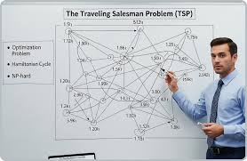
Traveling Salesman // Example
A salesman has to visit n cities, starting from her/his own
She/He must visit all the cities once, she/he cannot come back to the same city
She/He has to comeback to the starting city (forming a cycle)
Problem: what is the optimal sequence of cities to be visited?

Slide 19
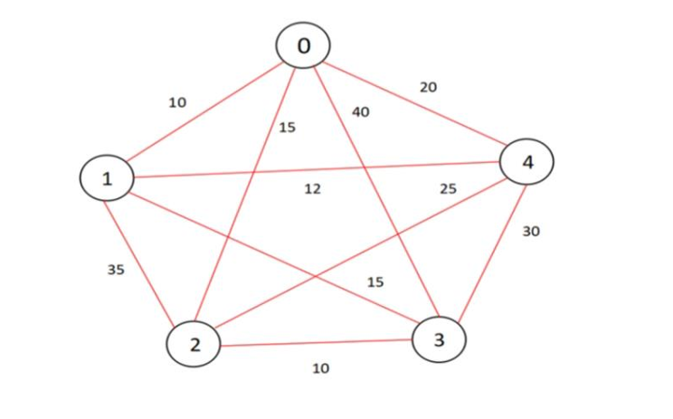
Traveling Salesman // Example
# | Path | Length
1 | 0-1-3-2-4-0 | 10+15+10+25+20=80
2 | 0-1-3-4-2-0 | 10+15+30+25+15=105
3 | 0-2-3-1-4-0 | 15+10+15+12+20=72
4 | 0-1-4-3-2-0 | 10+12+30+10+15=72
5 | 0-1-4-2-3-0 | 10+12+25+10+40=97
6 | 0-1-2-3-4-0 | 10+35+10+30+20=105
7 | 0-2-4-1-3-0 | 15+25+12+15+40=107
8 | 0-2-1-3-4-0 | 15+35+15+30+20=115
9 | 0-3-1-2-4-0 | 40+15+35+25+20=135
10 | 0-1-2-4-3-0 | 10+35+25+30+40=140
11 | 0-3-2-1-4-0 | 40+10+35+12+20=117
12 | 0-2-1-4-3-0 | 15+35+12+30+40=132
5 cities
We start from city 0 and we come back there (cycle)
Algorithm: brute force. Try them all!
There are 12 distinct paths

Slide 20
Traveling Salesman // Example
Heuristics: chose the closest city at each step, until all of them are visited
# | Path | Length
1 | 0-1-4-2-3-0 | 97
97 is not the optimal(72) solution but it is not the worst (140) and better than the average (106.4)

Slide 21

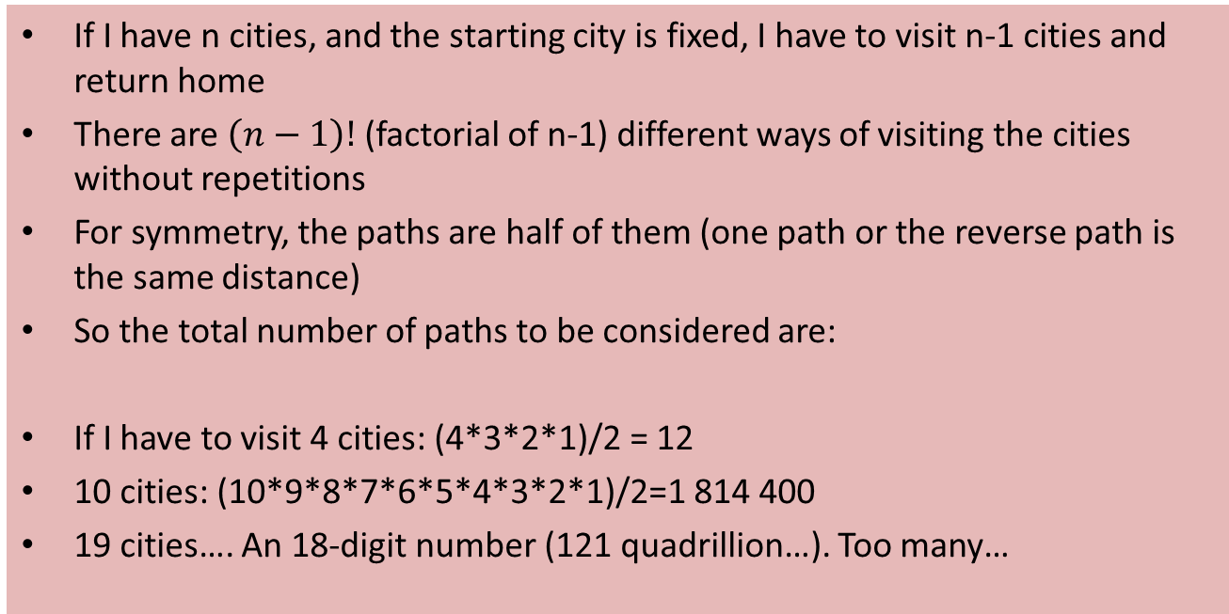
Why do I need an heuristics?
If I have n cities, and the starting city is fixed, I have to visit n-1 cities and return home
There are $\left(n−1\right)!$ (factorial of n-1) different ways of visiting the cities without repetitions
For symmetry, the paths are half of them (one path or the reverse path is the same distance)
So the total number of paths to be considered are:
If I have to visit 4 cities: (4*3*2*1)/2 = 12
10 cities: (10*9*8*7*6*5*4*3*2*1)/2=1 814 400
19 cities…. An 18-digit number (121 quadrillion…). Too many…
$$\frac{\left(n−1\right)!}{2}$$

Slide 22
What is a data structure?
A data structure is a way of organizing, managing, and storing data in a computer so that it can be accessed and modified efficiently.
Example: Think of a library. The books (data) can be organized in many ways: by genre, author's last name, or publication date. Each method of organization is a different "data structure" for the library.
Why Do We Need Data Structures?
Efficient Operations: Data structures are crucial for allowing algorithms to perform operations like searching, sorting, and adding data quickly and effectively.
Managing Complexity: They help simplify the representation and management of complex relationships between data points.

Slide 23
Examples of Data structure
List: The most fundamental data structure. It's a collection of data elements in a sequence.
Arrays: A fixed-size list where elements are stored in contiguous memory locations. Accessing an element by its index is very fast.
Linked Lists: A list where elements (nodes) are not stored in contiguous memory. Each node contains the data and a reference to the next node in the sequence.
Queue: A "First-In, First-Out" (FIFO) data structure. Like a line at a store—the first person in line is the first to be served. Operations are "enqueue" (add) and "dequeue" (remove).
Trees: a non-linear data structure that organizes data in a hierarchical manner. Example: The family tree is a great example. You have a root node at the top, with branches leading to child nodes.

Slide 24
The Relationship Between Algorithms and Data Structures
Working Together: An algorithm needs a data structure to operate on. For example, a search algorithm needs the data to be stored in an array or a tree to find a specific item. They are two sides of the same coin.
The choice of data structure can dramatically affect the efficiency of an algorithm.
Example: A search algorithm like binary search is incredibly fast, but it only works if the data is stored in a sorted data structure, like a sorted array or a binary search tree.

Slide 25
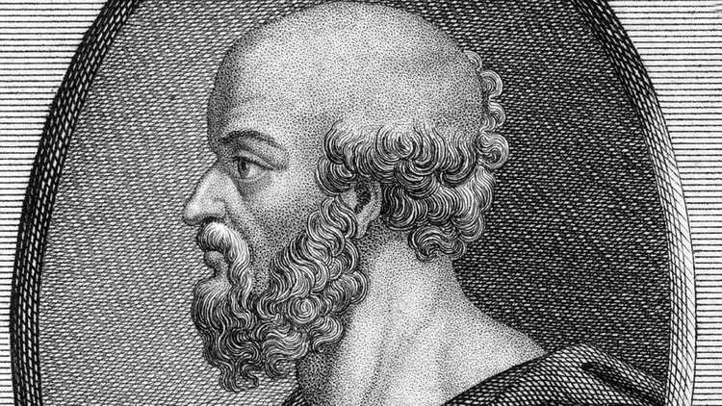
Algorithm of the week
The Sieve of Eratosthenes:
an algorithm to find the prime numbers up to n
Eratosthenes was a Greek polymath who became known as the father of geography.
He was a mathematician, poet, astronomer, the father of geography.
He calculated the circumference of the Earth and the distance from the Earth to the Sun He created the first map of the world
276 BCE in Cyrene (Libya) – 192 BCE in Alexandria, Egypt

Slide 26
The algorithm
All the multiples of a number n are not prime!
Start from 2, remove all the multiples of 2
Move to the next number n that has not been marked as prime
Remove all the multiple of n
Repeat

Slide 27
PseudoCode
This pseudocode finds all prime numbers up to a given integer 'n’
function sieve(n):
create a boolean array primes of size n+1.
Set all the elements of the array to true (=number is prime)
Mark 0 and 1 as not prime (primes[0]=false, primes[1]=false)
for p from 2 to n:
if primes[n]: (n is prime)
for i from p to n with a step of p:
primes[i] = false
If prime[p] is still true than p is prime

Slide 28
Optimizing the number of iterations
function sieve(n):
create a boolean array primes of size n+1.
Set all the elements of the array to true (=number is prime)
Mark 0 and 1 as not prime (primes[0]=false, primes[1]=false)
for p from 2 to n:
if primes[n]:
for i from p to n with a step of p:
primes[i] = false
If prime[p] is still true than p is prime
We need to go from 2 to sqrt(n) only
We can start from p^2, since all the smaller multiples (p, 2p, 3p) were already marked by a previous iteration of the loop

Slide 29
Optimized algorithm
function sieve(n):
create a boolean array primes of size n+1.
Set all the elements of the array to true (=number is prime)
Mark 0 and 1 as not prime (primes[0]=false, primes[1]=false)
for p from 2 to sqrt(n):
if primes[n]:
for i from p*p to n with a step of p:
primes[i] = false
If prime[p] is still true than p is prime

